Slide 1
Strat of the Ages
Christian Bravo
Justin Lawrence

Slide 2
Summary
Strat of the Ages is a resource management strategy game in which the player creates armies, takes over land, and creates diplomatic relations with other nations. The purpose of the game is to either acquire all opposing nations through warfare or create alliances such that there are no enemies to oppose you and you allies.

Slide 3
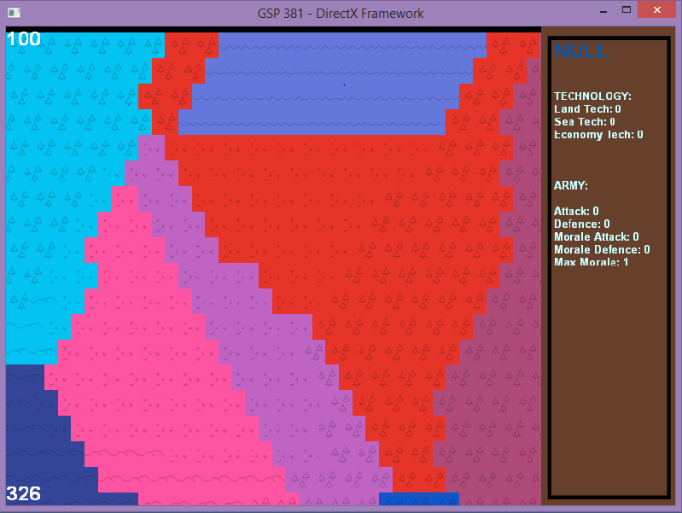
Features
Nations
Provinces
Armies
Diplomacy
Combat
War
Revolution

Slide 4
Responsibilities
Justin
Map Generation
UI Drawing
Initialization
Game Structure
Christian
AI
Movement/Pathfinding
Art Assets

Slide 5
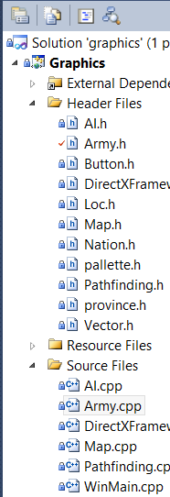

Issue Tracking
Git /Github
Issues
Milestones
Wiki
Visual Studio integrated

Slide 6
Demo

Slide 7
Lessons Learned
Understand code before attempting to use it
Ask questions
Balance programming vs planning

Slide 8
Questions

Slide 9
Thank you

